Slide 1
Diabetes Mellitus prediction using different Machine Learning Algorithms and their comparison
BY,
Anjali JHA (Sec f ,roll 9)
ATANU MONDAL (sec f, roll 16)
ROWNAK CHOWDHURY (sec f ,roll 47)
DEBALIKH CHATTERJEE (sec c ,roll 21)
ABHIJEET GOSWAMI (sec f, roll 1)
SUMIT KUMAR MONDAL (sec f , roll 71)
MENTORS:
PROF. STOBAK DUTTA
PROF. SUMIT ANAND

Slide 2
introduction
Diabetes mellitus refers to a group of diseases that affect how your body uses blood sugar (glucose).
PROBLEM STATEMENT:
Doctors rely on common knowledge for treatment. When common knowledge is lacking, studies are summarized after some number of cases have been studied. But this process takes time, whereas if machine learning is used, the patterns can be identified earlier.
PROPOSED SOLUTION:
Goal of the paper is to investigate for model to predict diabetes with better accuracy. We experimented with different classification and ensemble algorithms to predict diabetes.

Slide 3
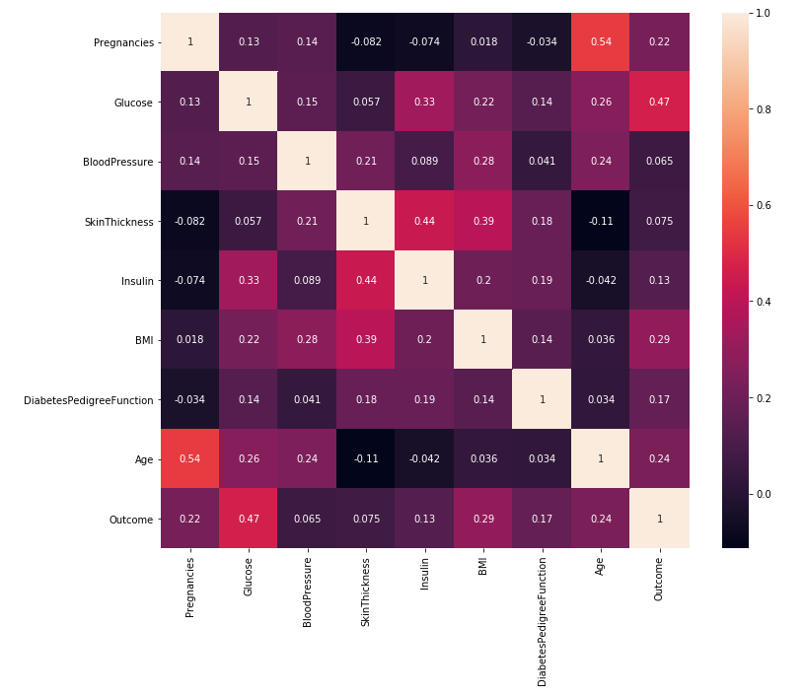
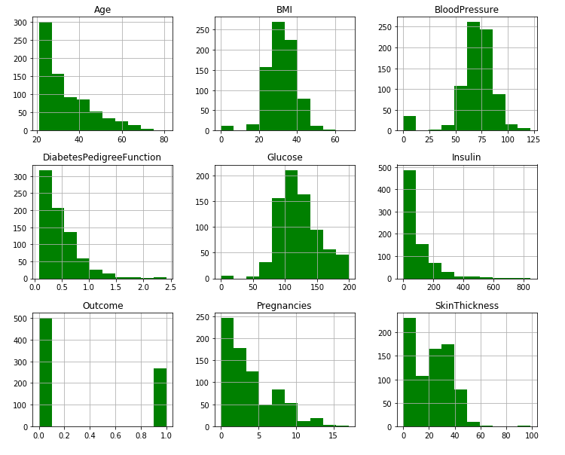
Dataset DETAILS
The dataset used in this study, is originally taken from the Pima Indian Diabetes Data set (publicly available at: UCI ML Repository).
DATA PREPROCESSING
DATA CLEANING
DATA REDUCTION
DATA TRANSFORMATION
HEATMAP TO SHOW THE RELATION BETWEEN DIFFERENT FIELDS
PRE PROCESSED DATA VISUALIZATION OF DIFFERENT FIELDS

Slide 4
DIFFERENT ALGORITHMS USED IN THE EXPERIMENT
RANDOM FOREST
LOGISTIC REGRESSION
SUPPORT VECTOR MACHINE
DECISION TREE
K NEAREST NEIGHBORS

Slide 5
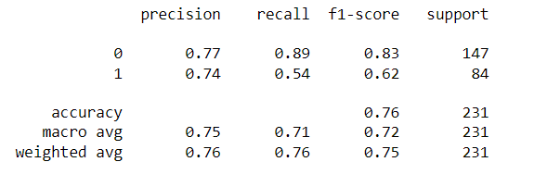
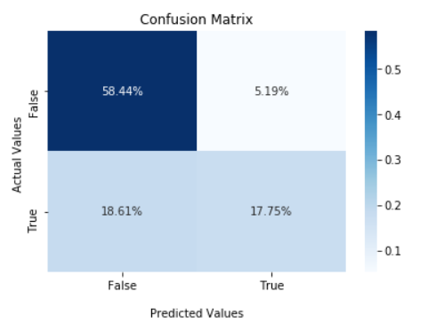
RANDOM FOREST
Random Forest is a supervised learning algorithm. The final prediction about an entity is given based on the predictions by the different decision trees.
Random Forest is a flexible and user-friendly machine learning algorithm that produces a great result .
Performance evaluation
Confusion matrix of proposed model

Slide 6
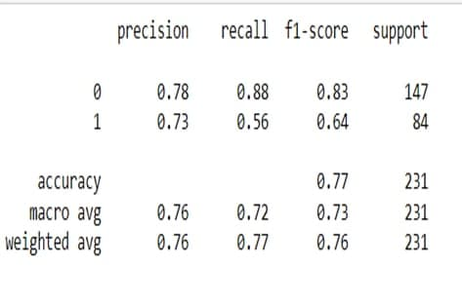
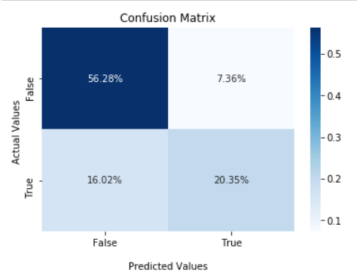
LOGISTIC REGRESSION
Logistic regression is the appropriate regression analysis to conduct when the dependent variable is dichotomous (binary).
Like all regression analyses, the logistic regression is a predictive analysis.
Performance evaluation
Confusion matrix of proposed model

Slide 7
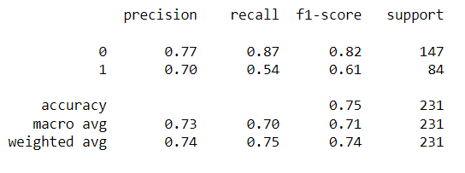
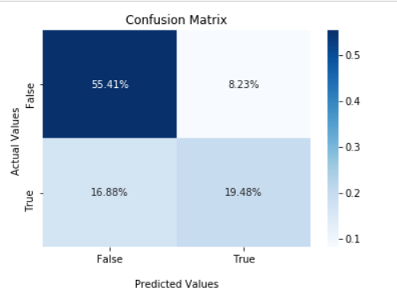
SUPPORT VECTOR MACHINE
SVM or Support Vector Machine is a linear model for classification and regression problems.
The algorithm creates a line or a hyperplane which separates the data into classes.
According to the SVM algorithm we find the points closest to the line from both the classes. These points are called support vectors.
Performance evaluation
Confusion matrix of proposed model

Slide 8
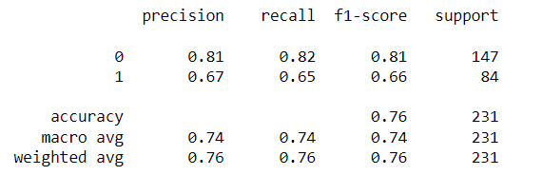
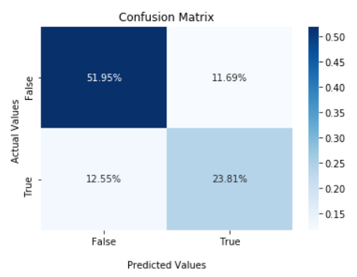
DECISION TREE
Decision Trees (DTs) are a non-parametric Supervised learning method used for classification and regression.
Below are the two reasons for using the Decision tree:
1.Decision Trees usually mimic human thinking ability while making a decision, so it is easy to understand.
2.The logic behind the decision tree can be easily understood because it shows a tree-like structure.
Performance evaluation
Confusion matrix of proposed model

Slide 9
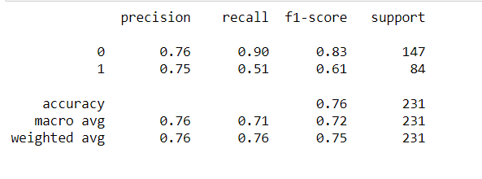
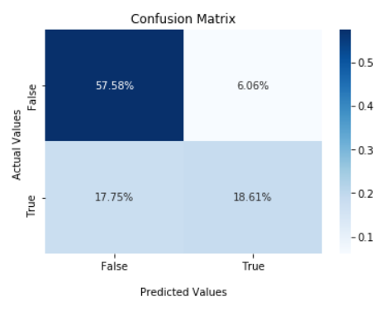
K NEAREST NEIGHBORS
K-nearest neighbors (KNN)
algorithm is a type of supervised ML algorithm which can be used for both classification as well as regression predictive problems.
The following two properties would define KNN well-
Lazy learning algorithm
Non-parametric learning algorithm
Performance evaluation
Confusion matrix of proposed model

Slide 10
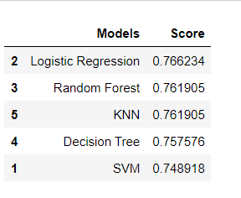
COMPARISON OF THE ALGORITHMS
Different classification algorithms were applied on our dataset, and results for all techniques were slightly different as the working criteria of each algorithm is different. The results were evaluated on the basis of accuracy.
Using Random Forest algorithm we obtained a best accuracy of 76.19%.

Slide 11
CONCLUSIONS
1.First, the random forest algorithm was applied. Experiments were done to tune the model with respect to the number of decision tress and the maximum depth of the decision trees. We obtained a best accuracy of 76.19%.
2.After the random forest algorithm, the SVM was applied to obtain better results. It divided the dataset into two classes on both side of hyperplane and obtain an accuracy of 74.8%.
3. Similarly other algorithms like decision tree, and KNN was applied to check the performance of model and we obtain an accuracy of 75.7% and 76.19% respectively.
4.Logistic regression was applied after all the algorithms which uses a sigmoid function and find a best fit regression between the dataset, ultimately giving us the highest accuracy of 76.6%.
5.All the models at the end were compared and we saw Logistic regression outperformed all.

Slide 12
THANK YOU

